Slide 1

Predicting Hotel Booking Cancellations: Insights for Revenue Management
The hotel industry faces a significant challenge in managing cancellations, impacting revenue and customer satisfaction. This presentation explores how machine learning can predict cancellations, empowering hotels to make data-driven decisions and optimize revenue management strategies.
Team:
Nagarjuna Reddy Sreerangapu
Ravitej

Slide 2
The Importance of Predicting Cancellations
Revenue Optimization
Customer Retention
Accurate predictions help hotels manage pricing and inventory effectively, increasing revenue and profitability.
Identifying potential cancellations allows hotels to proactively address guest concerns and enhance customer loyalty.

Slide 3
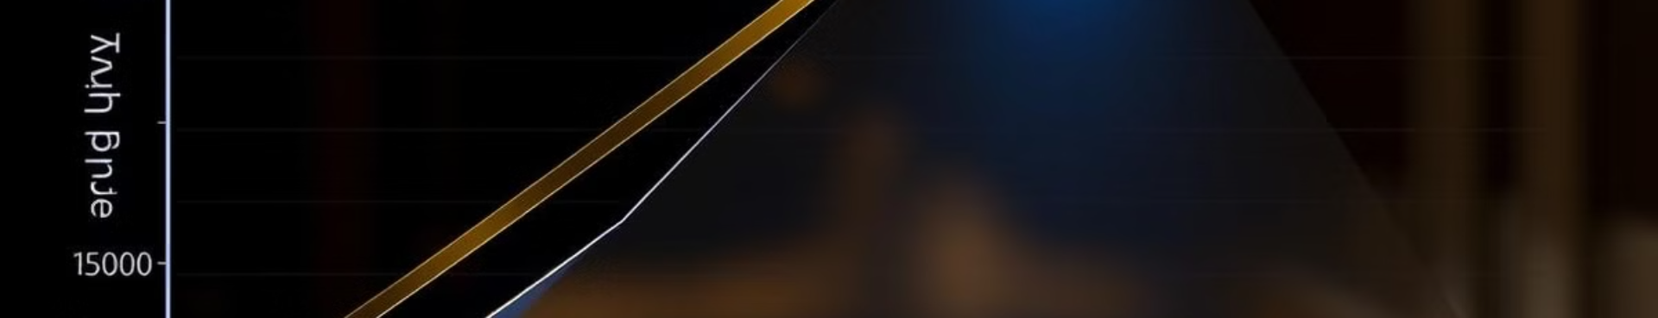
Understanding Key Factors
1
Average Daily Rate (ADR)
2
Repeat Guest Status
Higher ADRs may lead to a greater chance of cancellation.
Repeat customers are typically less likely to cancel due to established loyalty.
3
Lead Time
4
Previous Cancellations
Longer lead times might increase the likelihood of cancellations due to changing plans.
Guests with a history of cancellations are more likely to cancel again.

Slide 4
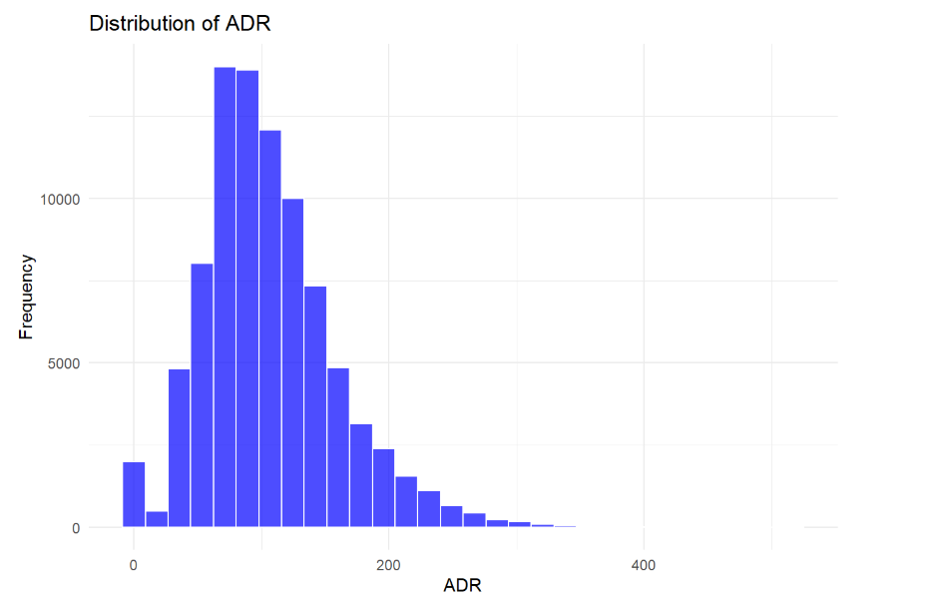
Distribution of ADR

Slide 5
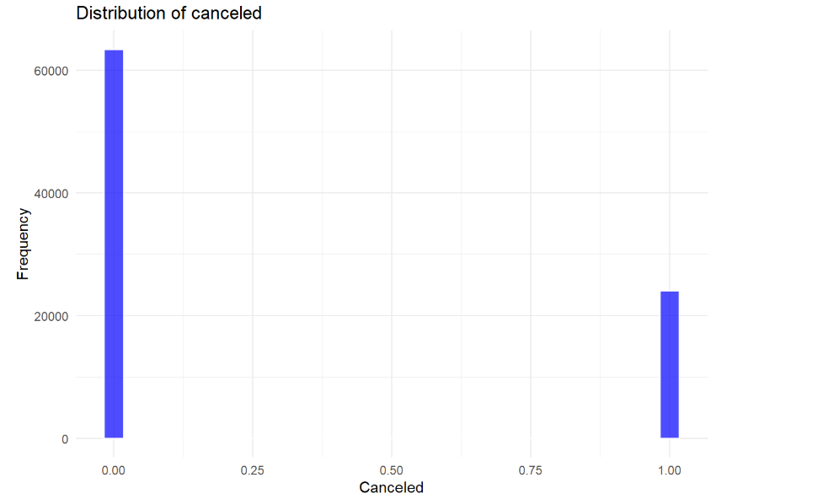
Distribution of Cancelled

Slide 6
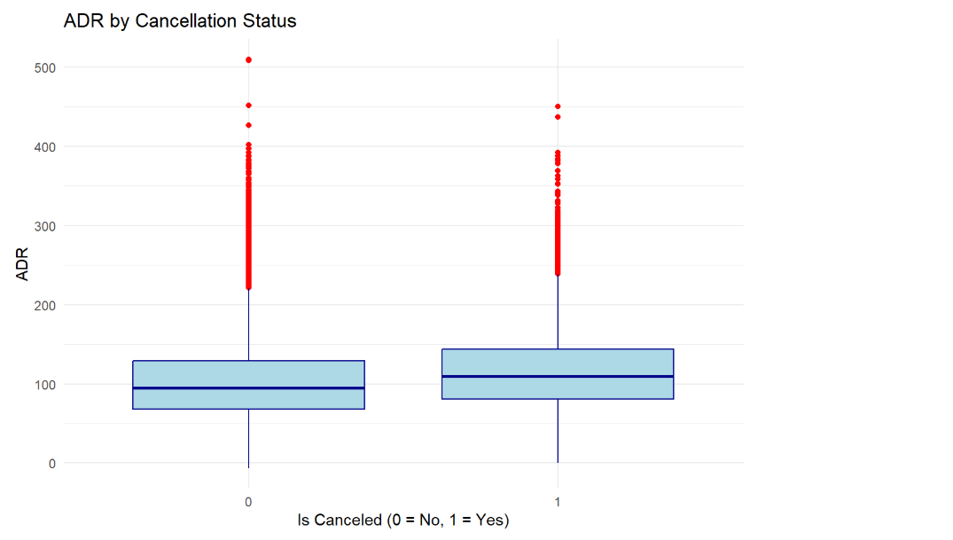
Distribution of ADR by Cancelled

Slide 7

Applying Machine Learning Techniques
Logistic Regression
Decision Trees
This model provides a simple and interpretable way to predict cancellations based on specific factors.
Decision trees offer insights into the importance of different features and how they influence cancellations.
Random Forest
This ensemble method combines multiple decision trees for greater accuracy and robustness.

Slide 8

Model Evaluation and Performance
Model | Accuracy | Precision | Recall | F1 Score | AUC
Logistic Regression | 0.7333 | 0.7364 | 0.9828 | 0.8462 | 0.6234
Decision Tree | 0.7319 | 0.7303 | 0.9975 | 0.8426 | 0.6234
Random Forest | 0.7382 | 0.7388 | 0.9867 | 0.8445 | 0.6234
The performance of each model was evaluated using metrics like accuracy, precision, recall, F1 score, and AUC. Random Forest demonstrated slightly higher accuracy and F1 score, indicating its effectiveness in predicting cancellations.

Slide 9
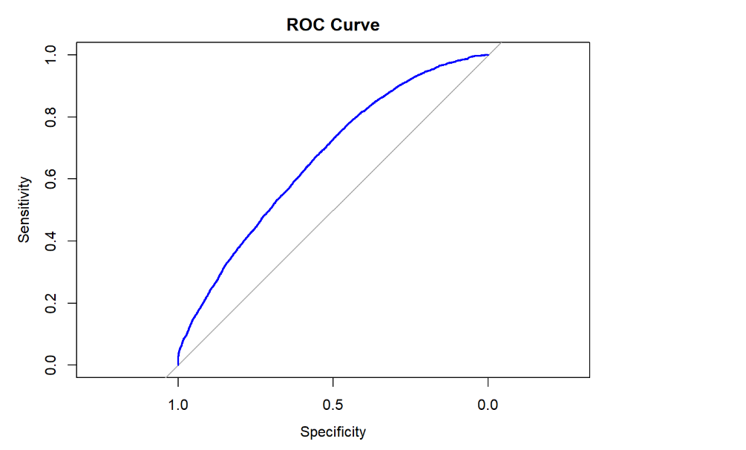
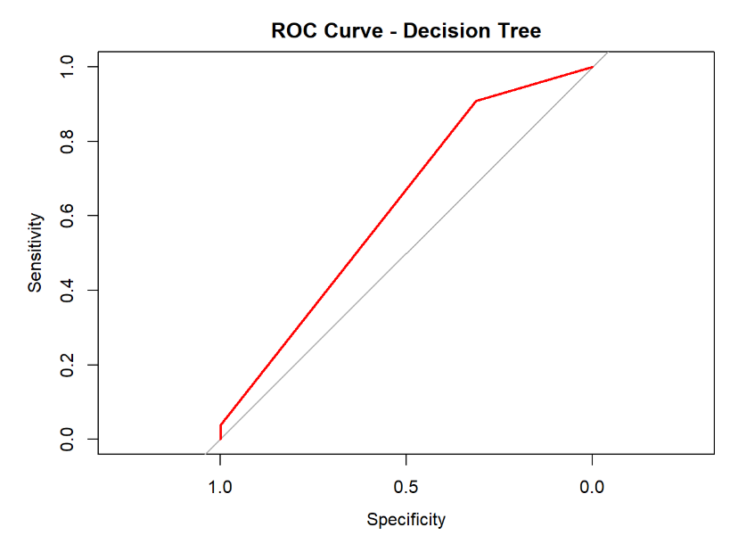
ROC curve
The image shows two ROC curves. The left one (blue) represents a better-performing model, while the right one (red) shows a decision tree model that doesn't perform as well and is closer to random guessing

Slide 10




Actionable Insights and Recommendations
Target Marketing
Segment customers based on cancellation risk to personalize marketing strategies and improve retention.
Adjust pricing based on cancellation probability to maximize revenue without losing bookings.
Implement proactive measures like flexible cancellation policies or incentives for high-risk bookings.

Slide 11

Continuous Monitoring and Improvement
As customer behavior evolves, it is crucial to continuously monitor and update predictive models. This ensures the models remain accurate and relevant for effective revenue management decisions.

Slide 12

Conclusion
By leveraging machine learning, hotels can gain valuable insights into cancellation patterns. Proactive strategies based on these insights empower hotels to improve revenue management and customer satisfaction.

